Slide 1

Rishab unique industrial park
Special Purpose Vehicle (SPV)
KALER BIOPHARMACHEM PVT. LTD.
Plot No. A-5, S.G. Enclave, Phase 1, Naushehra, Majitha Road
Amritsar, Punjab-143008.
Sponsored by
Kwality Pharmaceutical Limited
Nag Kala, Majitha Road, Amritsar, Punjab-143601 (India)

Slide 2

OBJECTIVE
Providing employment with training to new workers.
Rejuvenating the Red Industry.
Saving the congestion of working area in city.
Employment of 78000 workers in all relocated wholesale market.
Restoration of Red Industry and other Industries in 150 Acres of land in 127 plots.
Incorporation of new Investment of Rs. 2351 Crores from bank and capital markets in Individual heads.

Slide 3
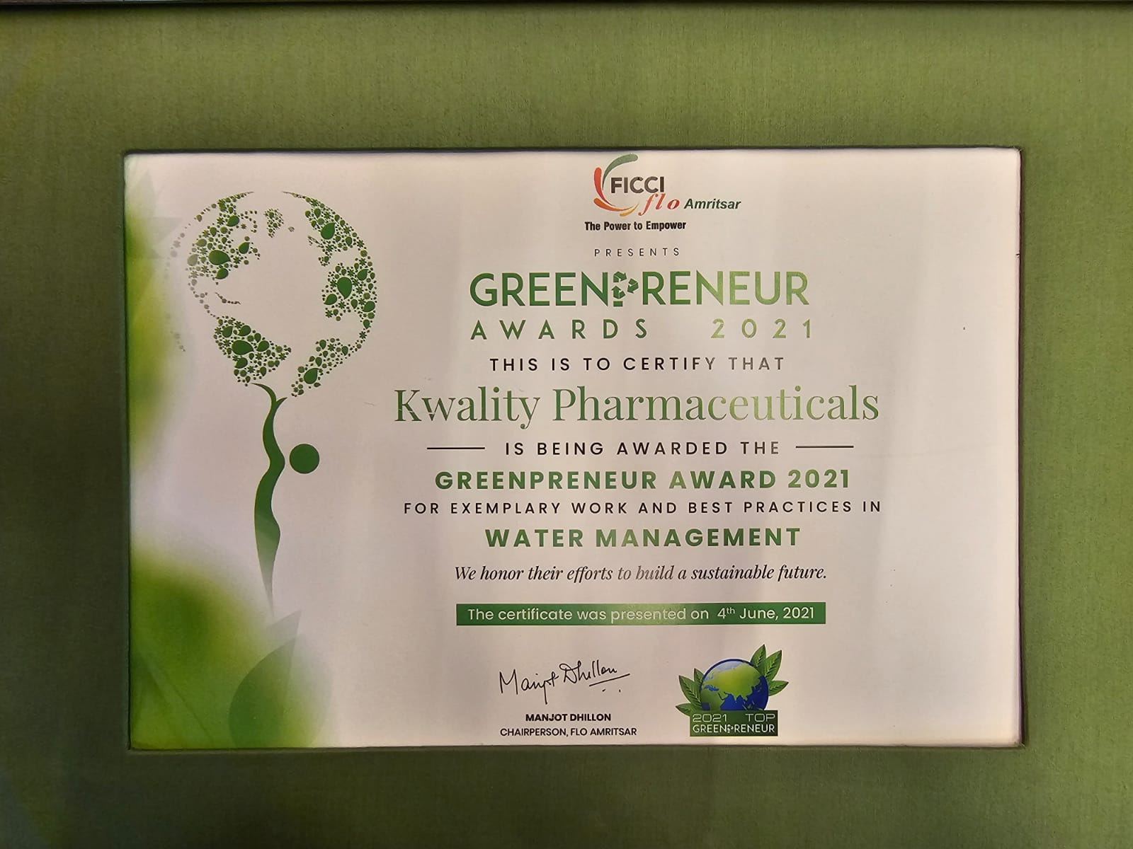
GREENPRENEUR AWARD 2021

Slide 4
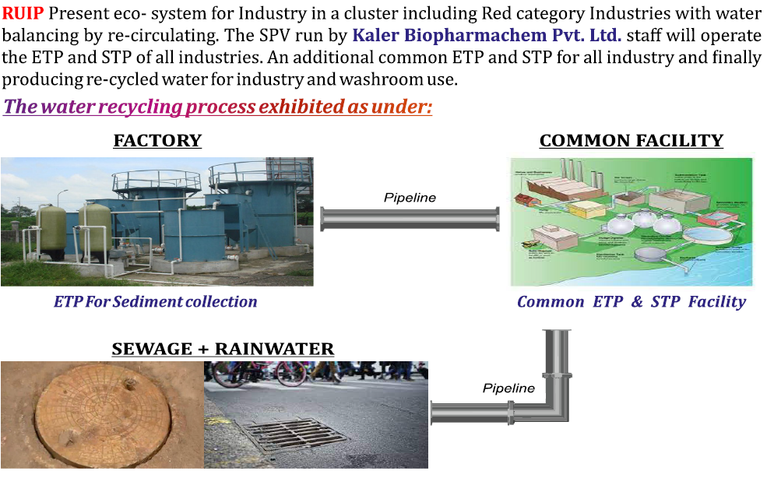
ECO-SYSTEM FOR INDUSTRY

Slide 5
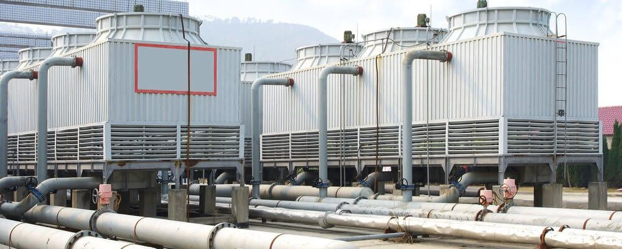
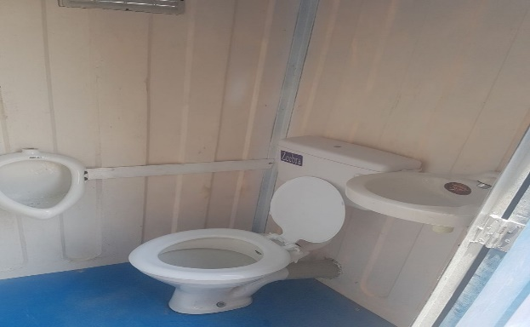
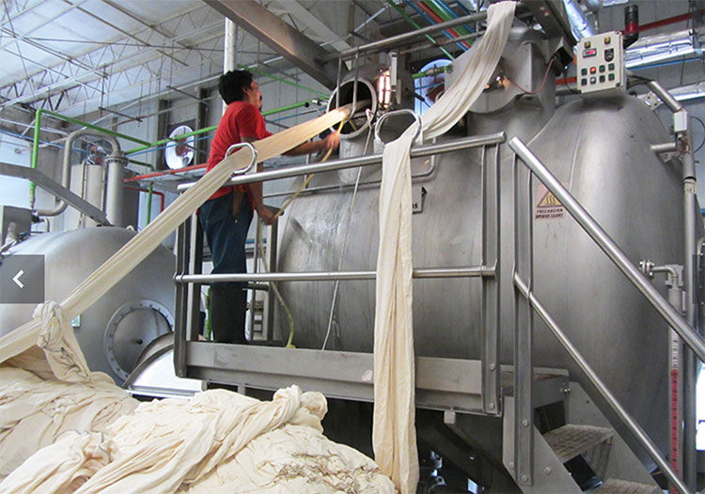
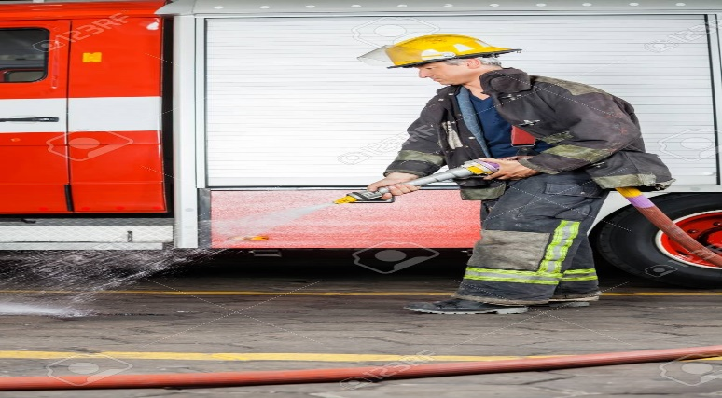
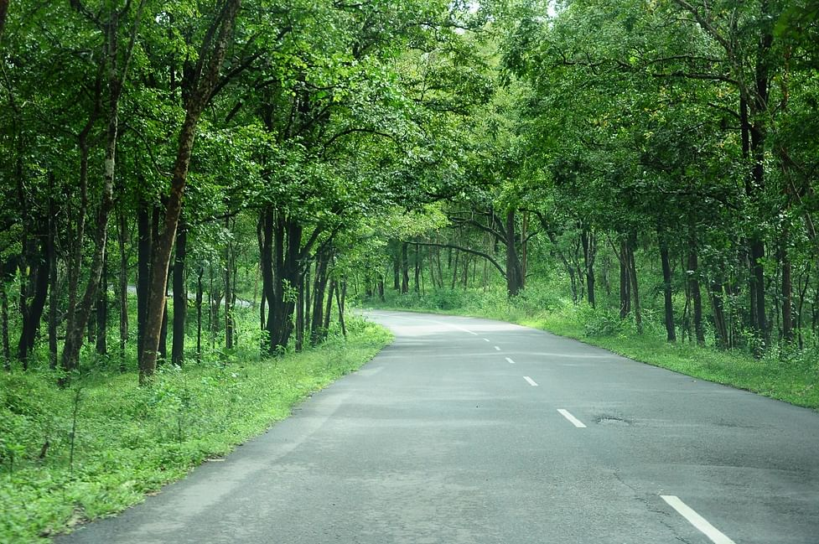
TREATED WATER USAGE
Low TDS Treated Water usage in cooling Tower
Low TDS Treated Water usage in Urinal and WC
Medium TDS Treated Water pass through water softening plant and usage in cloth cleaning.
Heavy TDS Treated Water usage in road cleaning
and dust set telling.
Heavy TDS Treated Water usage in gardening and planting

Slide 6
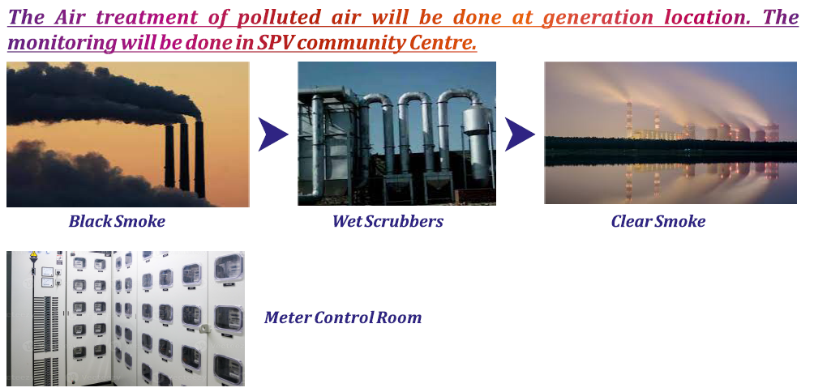
in community center

Slide 7
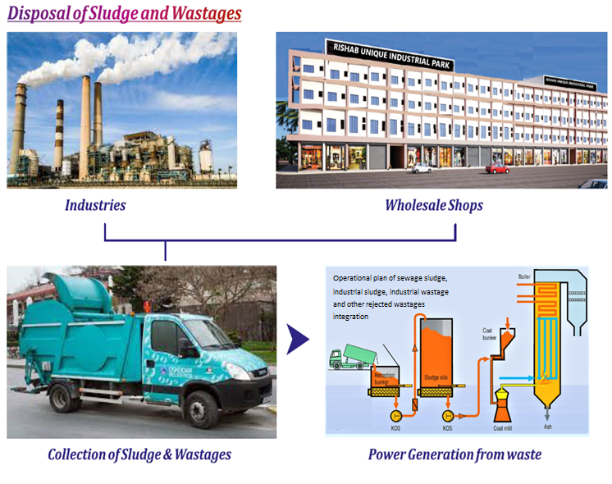

Slide 8
CONCEIVING OF IDEA
Kwality Pharmaceutical LTD. (KPL) is a company who has purchase a land to built up its own factories. The company has applied for CLU for setting up the industry. The CLU was refused as some of the land is green area and some area is marked as residential area and mixed zone as per PUDA map of 2010. KPL approached the Principal Secretary Mrs. Vinnie Mahajan and shared the idea of making an industrial area. Mrs. Mahajan after discussion and sharing the idea that we are running KPL at zero water discharge. She gave the idea why we are not making industrial park where other industries can also operate and park SPV try to balance their water and hence the idea of making industrial park came into our mind. We have studied Gujarat industrial park policies and also Punjab industrial park policy and available industrial park in Amritsar. No industrial park in Amritsar is accepting the red industry and they have ETP & STP and finally discharging the water. Since KPL have an experience to use the treated water of ETP & STP and recycling it. We wish to help the city where Red category industry is compelled to violate pollution norms. Many Red industries exists in area by hiding themselves. So we requested Mrs. Vinnie Mahajan we can utilize Industrial water discharge and give us a resolution of government by converting said land for industrial purpose. We made the representation to government of Punjab by giving projection of utilizing Industrial water. In our representation we requested government of Punjab for converting the residential, mixed area and agricultural land for commercial and industrial use on basis of zero water discharge. On our representation, the PUDA resolution was passed under PUDA notification 5780-5816/CTP (PB)/SP-135 dated 24.09.2021 .

Slide 9
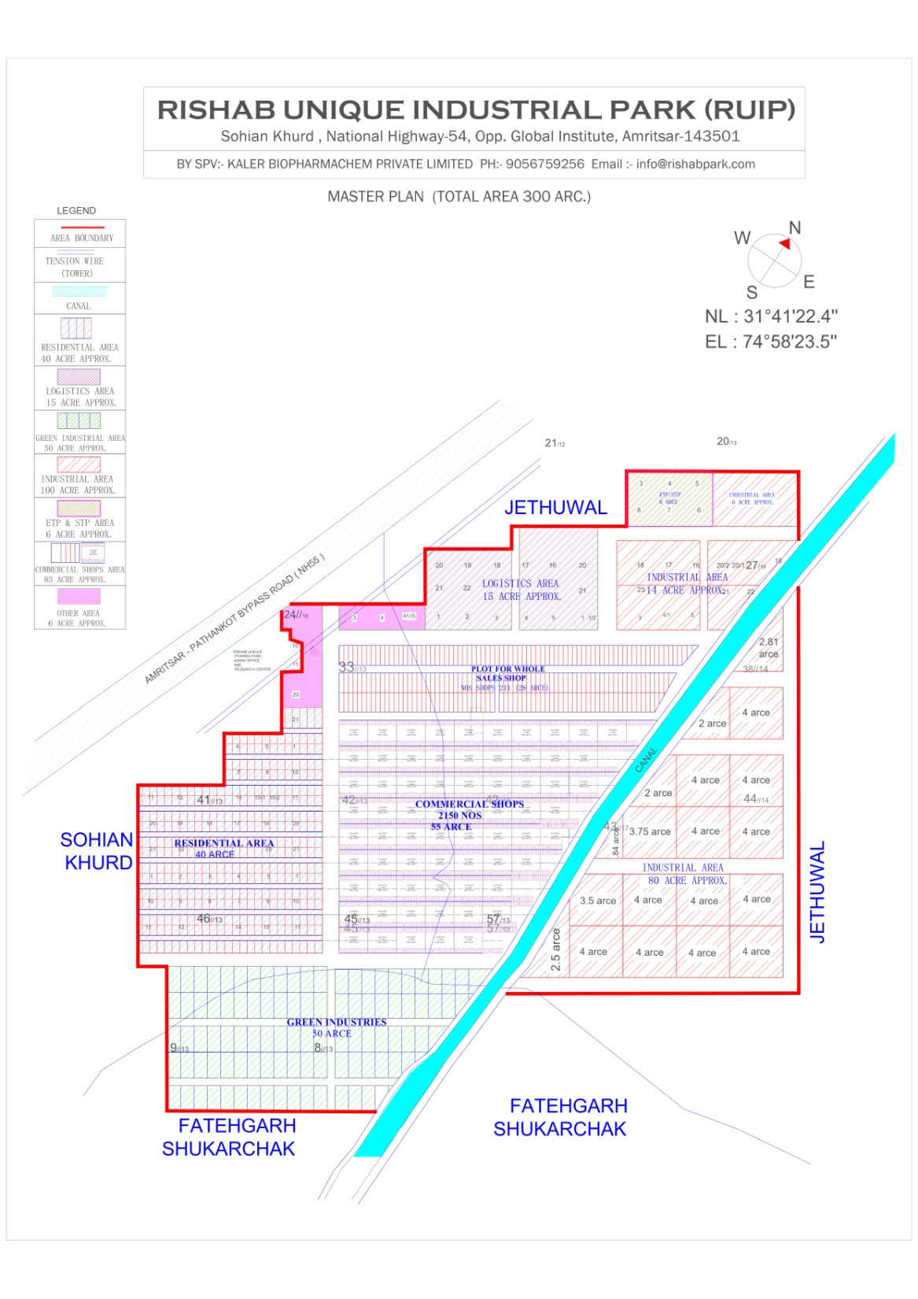

Slide 10
SERVICES
Part-A common for all Participants (Wholesaler and Industry and Transport)
Part-B special services each category of participant.
Part-A Service: General Facility
Community Building facility consist of: Definition- The facilities available within the community centre.
  Community training Centre for staff and workers.
  Booking of shops and delivery.
  Community Canteen.
  Community Lockers.
  Community Night Halts.
  Community commercial Banks.
  Community Conference room.
  Community restaurant.
  Community washroom including bathing facility.
  Community Fire Brigade
  Community Bus Facility
  Community E-Rickshaw.

Slide 11
SERVICES CON..
Hygiene
  Definition: It is related to greenery facility under taken by the corporate.
  Community washroom accessible within 200 feet maximum i.e. after 20 shops only for wholesale market blocks.
  Cleaning of veranda and shop front glass only for wholesale market blocks.
  Cleaning of roads and lifting of wastages.
  Sewage treatment plant.
  Water supply.
  Wastage collection from dustbin and road.
  Disposal of wastages by incinerator.
  Cleaning by water shower of fire brigade

Slide 12
SERVICES CON..
Common Facility out of community centre
  Definition: These are the facility provided by the corporate which are not within the premises of community building
  Road and Parking.
  Additional area of parking.
  Commercial Bank Complex and ATM.
  Common Warehouse and Personal Warehouse.
  Loading and Unloading area for goods.
  Fork lifter for goods.
  Transportation
  Courier services.
  Procurement of transportation.
  Compressed packing of bails.

Slide 13
SERVICES CON..
E-Facility
  Definition: It is related to internet provider and other IT related infrastructure like; cameras, computers, software programme etc.
  Management of Warehouse by Software including placement and dispatch of goods.
  Optical fiber internet to all shops.
  Accountant facility with software.
  Stock management facility with software.
  Gallery in facebook and whatsapp.
  Software application for finding location, dustbin, washrooms and community building.
  PBX System available on phones and as handset.
  Coding of your stock.
  Sale bill by coding or RF ID sale bill.

Slide 14
SERVICES CON..
Corporate Facilities
  Definition: The arrangement of the facility on the corporate land generated by corporate only which will not be given to third party.
  Club ground for extracurricular activity.
  Zoo
  Amusement Park.
  Exhibition Ground.
  Rehri Market.
  Electricity Sub-station 66000 Volts to 11000 Volts.
  Security from outside.
  Publicity of Park area and shops.

Slide 15
SERVICES CON..
Registered as Suppliers
  Definition: To build the park these persons are required to make the supplies to built infrastructures by corporate. Similarly the other participant who requires these services will have ready reference of registered supplier as their names are published on the website.
  Building material suppliers
  Electricity goods suppliers.
  Office furniture suppliers.
  Contractor of construction.
  IT equipment suppliers.
  Hardware suppliers.
  Sanitary goods suppliers.
  Generator suppliers.

Slide 16
SERVICES CON..
PART-B Services: Special Services
For industry:
Community centre provides the following services through its Liaison Officer.
  The interacting offices of invest Punjab for getting incentives for industry
  Interacting with SIDBI for taking bank loan for machinery.
  Liaising with labor department, provident fund and ESI department.
  Liaising with pollution department
  Liaising with factory Act.
  Liaising with GST.
Registration with Deputy Director of Foreign Trade for IEC Code (Import Export Code) and Licenses.
Export Promotion Council Registration.
Common STP & ETP
Maintenance of STP & ETP of all industrial units for captive consumption of water.
Execute all the exemptions and incentives of invest Punjab, Central government and income tax rate settlements.
  Exemptions from Building Cess.
  Exemption from CLU charges.
  Exemption from Water extraction charges.
  Exemption from establishment charges.
  Incentive of income tax for new units.

Slide 17
Type of Wholesale Market
Sr. No. | Manufacturers and Wholesalers of Clothes Market Suiting & Shirting images | Number of Shops | Number of Shops on Ground Floor | Shops in 3 Floors | Structure Possibility upto 5 Floor and construction only upto 3 floors employment calculation upto 4 floors | Number of Employees in each shop | Total number of Employees in each group | Shop Dimension in clear Area in Feet
1 | Packing cloth industry with wholesale shop | 211 | 211 | 0 | 0 | 20 | 4220 | 35 X 150
2 | Manufacturers and Wholesalers of Clothes Market Suiting & Shirting images | 120 | 120 | 360 | 480 | 6 | 2880 | 12 x 36 + 8 Feet Veranda
3 | All Types of Ladies Unstitched Garments | 180 | 120 | 360 | 480 | 6 | 2880 | 12 x 36 + 8 Feet Veranda
4 | All Types of Ladies & Gents Readymade Garments | 120 | 120 | 360 | 480 | 6 | 2880 | 12 x 36 + 8 Feet Veranda
5 | All Household Cloths (Curtains, Blanket Cover and coats wool cloth and Various Cloth Not covered any ware in above 1,2,3) | 90 | 120 | 360 | 480 | 6 | 2880 | 12 x 36 + 8 Feet Veranda
6 | Plastic goods of all kind including plastic Furniture Market | 120 | 120 | 360 | 480 | 6 | 2880 | 12 x 36 + 8 Feet Veranda
7 | Wholesale paper duplex board and printing material market and Stationary Market | 90 | 120 | 360 | 480 | 6 | 2880 | 12 x 36 + 8 Feet Veranda
8 | Herbal goods wholesale Market | 90 | 120 | 360 | 480 | 6 | 2880 | 12 x 36 + 8 Feet Veranda
9 | Chemical and flavour Market | 90 | 120 | 360 | 480 | 6 | 2880 | 12 x 36 + 8 Feet Veranda
10 | Wholesale medicine market and surgical goods market | 90 | 120 | 360 | 480 | 6 | 2880 | 12 x 36 + 8 Feet Veranda
11 | Hardware goods Wholesale Market | 90 | 120 | 360 | 480 | 6 | 2880 | 12 x 36 + 8 Feet Veranda
12 | Electric and electronic goods Wholesale Market (TV, Freeze, Mobile, Mobile Accessories, AC, Cooler etc.) | 90 | 120 | 360 | 480 | 6 | 2880 | 12 x 36 + 8 Feet Veranda
13 | Automobile parts wholesale Market | 90 | 120 | 360 | 480 | 6 | 2880 | 12 x 36 + 8 Feet Veranda
14 | Wholesale Furniture and Fixuture market and Furniture Material Markets | 90 | 120 | 360 | 480 | 6 | 2880 | 12 x 36 + 8 Feet Veranda
15 | Wholesale building material and sanitary goods market (Tiles, Plumber etc.) | 90 | 120 | 360 | 480 | 6 | 2880 | 12 x 36 + 8 Feet Veranda
16 | Grain market, Dairy and Food Products, Dry Fruit Market etc. related to Food like; Tea, Sugar etc. | 90 | 120 | 360 | 480 | 6 | 2880 | 12 x 36 + 8 Feet Veranda
17 | Utensils and Crockery Market | 90 | 90 | 270 | 360 | 6 | 2160 | 13 x 36 + 8 Feet Veranda
18 | Home Decoration Market | 60 | 60 | 180 | 240 | 6 | 1440 | 14 x 36 + 8 Feet Veranda
19 | Crackers Market | 60 | 60 | 180 | 240 | 6 | 1440 | 15 x 36 + 8 Feet Veranda
20 | Leather and Shoes, Purse and all leathers Market | 60 | 60 | 180 | 240 | 6 | 1440 | 16 x 36 + 8 Feet Veranda
21 | Wooden Furniture Market | 60 | 60 | 180 | 240 | 6 | 1440 | 17 x 36 + 8 Feet Veranda
22 | Export & Import of Fruit and Vegetables Market | 79 | 79 | 237 | 316 | 6 | 1896 | 18 x 36 + 8 Feet Veranda
Total |  | 2150 |  |  | 8600 |  | 57236

Slide 18
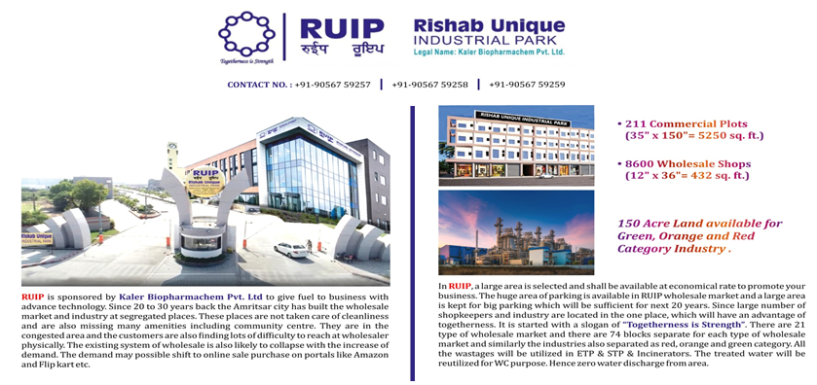

Slide 19

Scope of Projects
Establishment of SPV with under 34 facilities which include common ETP, STP and inclination.
Revalidation of Red Industry and distilleries.
International compactable textile industry.
Systematic go down system.
Transport courier industry in large area.
Wholesale business of 22 categories.

Slide 20
THANK YOU

